Slide 1
A multilingual hate speech detection using machine learning and deep learning model

Slide 2
COURSE TEACHER
Mr M M Fazle Rabbi
Department of Computer Science and Engineering(CSE)
PROJECT SUPERVISOR
Mr.Md. Ashiqur Rahman
Assistant Professor
Department of Computer Science and
Engineering(CSE)
TEAM MEMBERS
Mosfeq Ahamed Nayim
ID: 19203103057; 45/02
Bayzid Simon Sarkar
ID: 19203103082; 45/02
Sumiya Hossain Niha
ID: 19203103065; 45/02
Md. Riyad Hossain
ID: 19203103102; 45/02
Mst. Kanij Fatema
ID: 19203103103; 45/02

Slide 3
CONTENT
1.Introduction
2.Motivation
3.Research Contribution
4.Dataset of Bengali Language
5.Dataset of English Language
6.Summary Literature Review
7.Methodology
8.Data processing
9.Conclusion

Slide 4
Introduction
Global Hate Speech Solution:
  Tackling hate speech on a global scale.
Advanced Technology Integration:
  Using machine and deep learning for effective detection.
Inclusive Online Environments:
  Developing a smart system to enhance safety and inclusivity.

Slide 5
Motivation
Fostering a safer online environment for users worldwide, regardless of language.
Minimizing the international propagation of hate speech through various languages.
Upholding cultural sensitivity by understanding diverse linguistic contexts.
Creating a more ethical and responsible digital ecosystem.
Encouraging diversity and unity within varied language communities.

Slide 6
Research Contribution
Collected English and Bengali language dataset from publicly available sources.
Combined the English and Bengali language datasets for multilingual hate speech detection purpose.
Tokenization of data.
Apply and evaluate different machine learning and deep learning model.

Slide 7
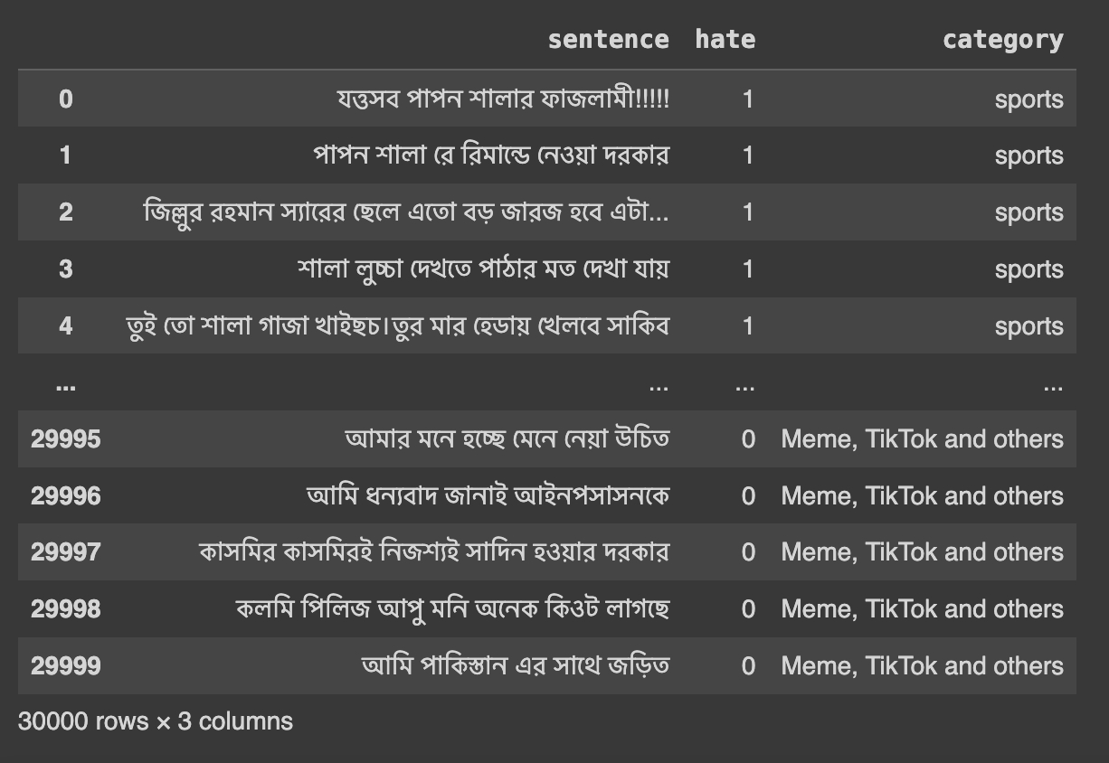
Dataset of bengali Language
There are 30000 rows .
There are 3 columns,
Sentence
Hate
Category

Slide 8
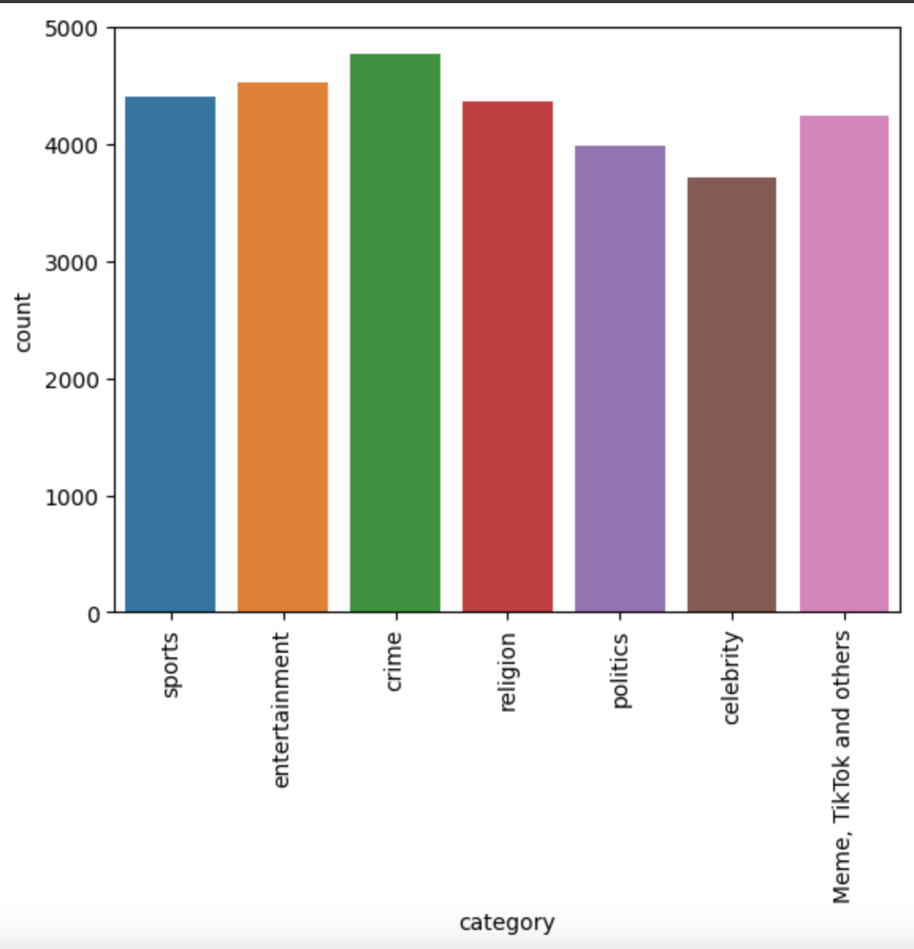
Hate speech are divided into 7 categories.
Sports
Entertainment
Crime
Religion
Politics
Celebrity
Meme,tiktok and others

Slide 9
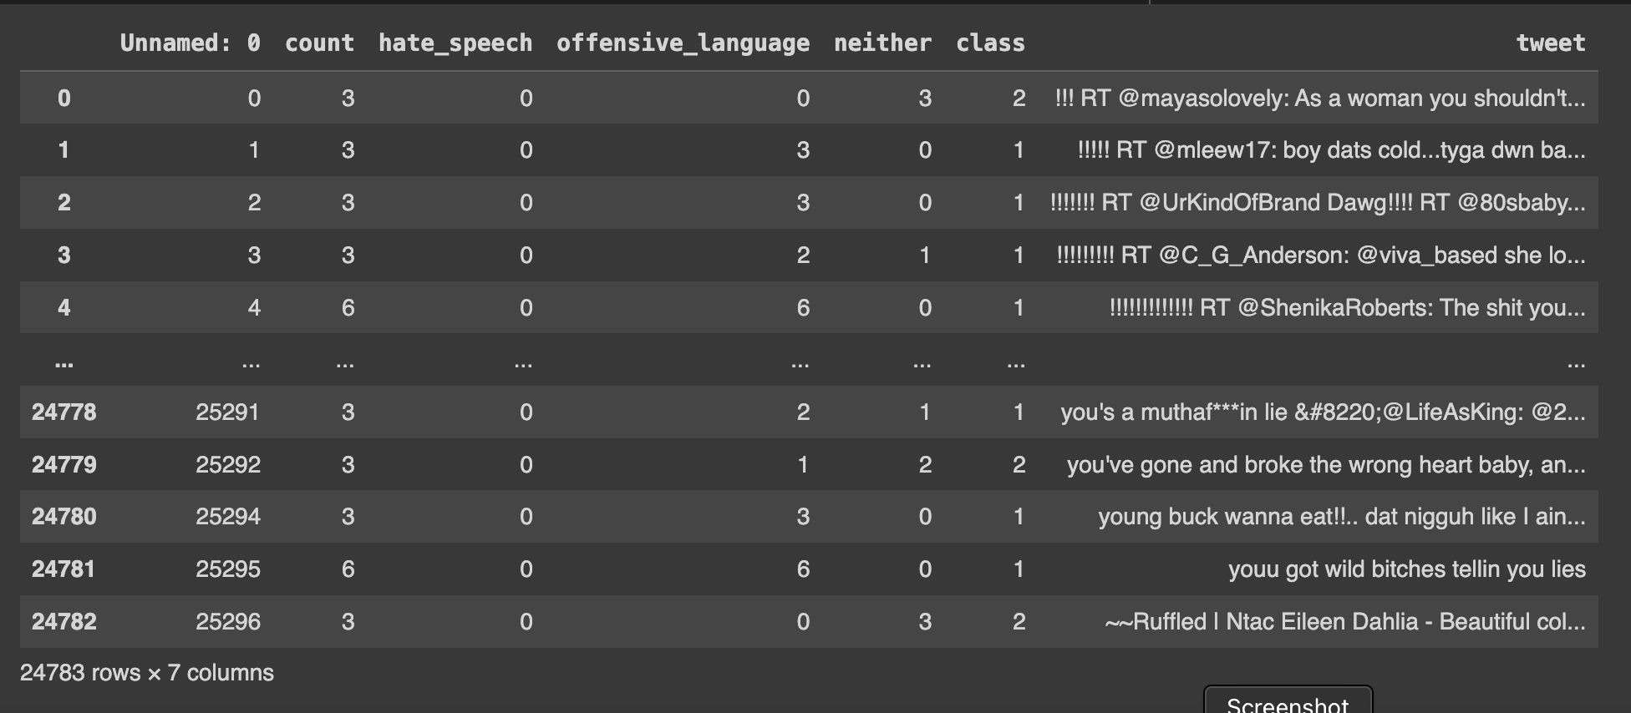
Dataset of English Language
There are 24783 rows.
There are 7 column.
Count
Hate speech
Offensive language
Neither
Tweet

Slide 10
Summary Literature Review
Reference | Research Purpose | Research Methods | Results | Challenges/Research Gaps
1 | Multilingual Hate Speech Detection | BERT | 83% | Wrong classification due to annotation’s dilemma (AD), Wrong classification due to confounding factors (CF), Wrong classification due to hidden context (HC)
2 | Bengali Hate Speech Detection | BERT | 97% | Limited dataset
3 | Multilingual Hate Speech Detection | BERT | 89% in English, 87% in malay. | Limited range of hyperparameters of the BERT models
4 | Limited range of hyperparameters of the BERT models | DistilBERT | 80.36% | Shortage of collected data

Slide 11
Summary Literature Review
Reference | Research Purpose | Research Methods | Results | Challenges/Research Gaps
5 | Cross-Lingual Few-Shot Hate Speech and Offensive Language Detection | Proto-MAML | 63.1% | Shortage of collected data
6 | Hate Speech detection in the Bengali language: A dataset and its baseline evaluation | SVM | 87.5% | The lack of sufficient data.
7 | Hate speech detection: Challenges and solutions | BERT,Multi-view SVM | 82.01% | Need for more research on technical and practical matters.

Slide 12
Summary Literature Review
Reference | Research Purpose | Research Methods | Results | Challenges/Research Gaps
8 | Hate speech detection on social media using neural network | Recurrent neural network (RNN),CNN | 77% | The lack of sufficient data.Further,need more datasets.
9 | Hate Speech and Offensive Language Detection in Bengali | m-BERT,XLM-Roberta,IndicBERT,muRIL,ELFI | 83% | only analyzed publicly available data crawled via Twitter API.
10 | SOCIAL MEDIA COMMENTS FOR HATE SPEECH DETECTION IN BANGLA | BERT | 86.78% | Found that emoji and punctuation do not affect HS detection

Slide 13
Summary Literature Review
Reference | Research Purpose | Research Methods | Results | Challenges/Research Gaps
11 | Multilingual Racial Hate Speech Detection Using Transfer Learning | BERT and HateXplain | 88% F1-score 86% | Due to the limitation of time they were unable to research further.
12 | Automated Sentiment and Hate Speech Analysis of Facebook Data by Employing Multilingual Transformer Models. | XLM-T and NLP | F1-score Hateful 71% Non-hateful 83% | Hateful Speech detection Precision is only 55%
13 | Large Annotated Dataset for Multi-Domain and Multilingual Hate Speech Identification. | BERT-Zero Shot | 93% | Cannot detect leetspeak

Slide 14
Summary Literature Review
Reference | Research Purpose | Research Methods | Results | Challenges/Research Gaps
14 | Combating Hate: How Multilingual Transformers Can Help Detect Topical Hate Speech | LASER + SVM Baseline, mBERT | Lowest 68.2% and highest 85% | Smaller datasets with class imbalance produced a weak fit
15 | LMU at HaSpeeDe3: Multi-Dataset Training for Cross-Domain Hate Speech Detection. | AlBERTo, UmBERTo, mBERT and XML-R | 64% | The accuracy is not that great. More data required.
16 | Hate Speech Detection in Italian Social Media Text | XML-Base, XLM-Large, mBERT, ITA-Base-XXL | 88.63% | Limited evaluation of hate speech detection models on Italian language subset.

Slide 15
Summary Literature Review
Reference | Research Purpose | Research Methods | Results | Challenges/Research Gaps
17 | Multi-Task Learning Approach to Hate Speech Detection | BERT,BETO | 86.58% | Limited focus on improving dataset quality for enhanced model learning.
18 | BERT-Mini Model for Hate-Speech Detection | BERT | 98.6% | Does not thoroughly investigate how to optimize the BERT model for better performance
19 | Emotionally Informed Hate Speech Detection | ELMo, CNNFastText, BERT | 91.3% | The research does not fully consider how the meaning of words and context affects accurately identifying hate speech.

Slide 16
Summary Literature Review
Reference | Research Purpose | Research Methods | Results | Challenges/Research Gaps
20 | Hate Speech Detection Using Natural Language Processing Techniques | CNN | 91% | Limited dataset
21 | Political and Religious Hate Speech Detection | BERT | 91% | Out-of-domain setting does not work properly.
22 | Hate Speech | BERT,G-BERT | 95.56% | Multiple language sentences are included in the Dataset. Some languages have less data .

Slide 17
Summary Literature Review
Reference | Research Purpose | Research Methods | Results | Challenges/Research Gaps
23 | Bengali Hate Speech Detection | BERT | 80% | Shortage of collected data
24 | Contextual Information in Hate Speech Detection | BERT | 61.3% | we can observe that the dataset has complex,limited dataset, long contexts.
25 | Bangla hate speech | G-BERT | 95.56% | Banglish sentence is not included

Slide 18
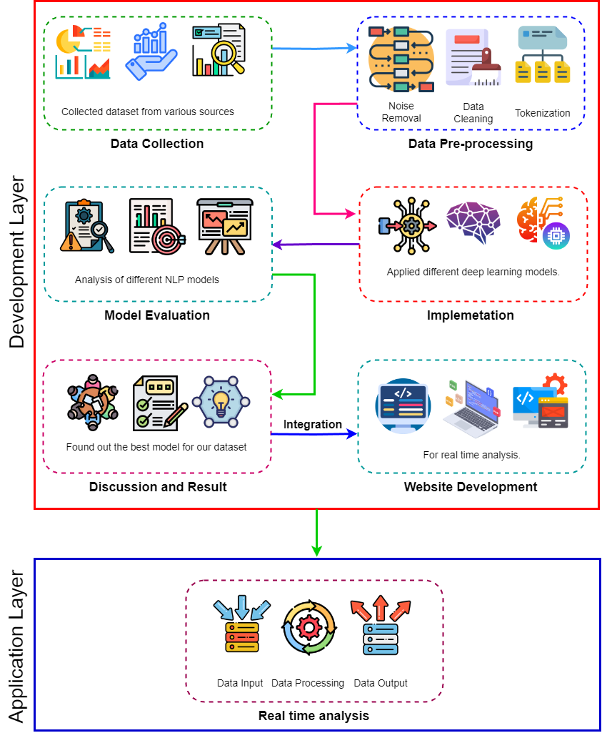
Methodology
Steps
We collect dataset .
Pre-process the data.
Model evaluation.
Implementation.
Result.
Create website for real time analysis.

Slide 19
Data Pre-Processing
The data pre-processing has occurred in three stages-
Noise removal: In this part we remove the Stopwords from the text.
Data cleaning: In this part we remove the special characters from the text and convert the data into lowercase letters.
Tokenization: Tokenization can separate words from sentences and allows algorithms to identify offensive terms easily.

Slide 20
Conclusion
In conclusion, the use of machine learning and deep learning models for multilingual hate speech detection has shown promise in effectively identifying and classifying hate speech in different languages. Deep learning models, such as CNNs and LSTMs, have demonstrated superior performance compared to traditional machine learning models. Large datasets containing hate speech examples in multiple languages are crucial for training these models. The process involves data preprocessing, tokenization, vectorization, and fine-tuning model parameters. These models have the potential to contribute to safer online environments by mitigating the impact of hate speech.

Slide 21
Thank You

